Slide 1


Brazilian E-Commerce Data and Prediction Analysis
Abonia Sojasingarayar-M2
Aissatou BA-M1
Artificial Intelligence-IA school
June,2020 Guided By: Manel Boumaiza
Prof IA-IA School

Slide 2
Table Of Content
Introduction and Dataset
Inspiration
Data Schema
Database ER Diagram
Data Analysis and Visualisation
Customer Satisfaction Prediction
ML Algorithm Comparision
Feature Importance
Future Work
Conclusion

Slide 3
Introduction
Brazilian ecommerce public dataset of orders made at Olist Store.
The dataset has information of 100k orders from 2016 to 2018 made at multiple marketplaces in Brazil.
This dataset was generously provided by Olist, the largest department store in Brazilian marketplaces. Olist connects small businesses from all over Brazil to channels without hassle and with a single contract.

Slide 4
Inspiration
NLP: This dataset offers a supreme environment to parse out the reviews text through its multiple dimensions.
Clustering: Some customers didn't write a review. But why are they happy or mad?
Sales Prediction: With purchase date information we can able to predict future sales.
Delivery Performance: Delivery performance and find ways to optimize delivery times.
Customer Satisfaction: Predicting customer satisfaction.
Feature Engineering: Create features from this rich dataset or attach some external public information to it.

Slide 5

Data Schema
Source:https://www.kaggle.com/olistbr/brazilian-ecommerce

Slide 6
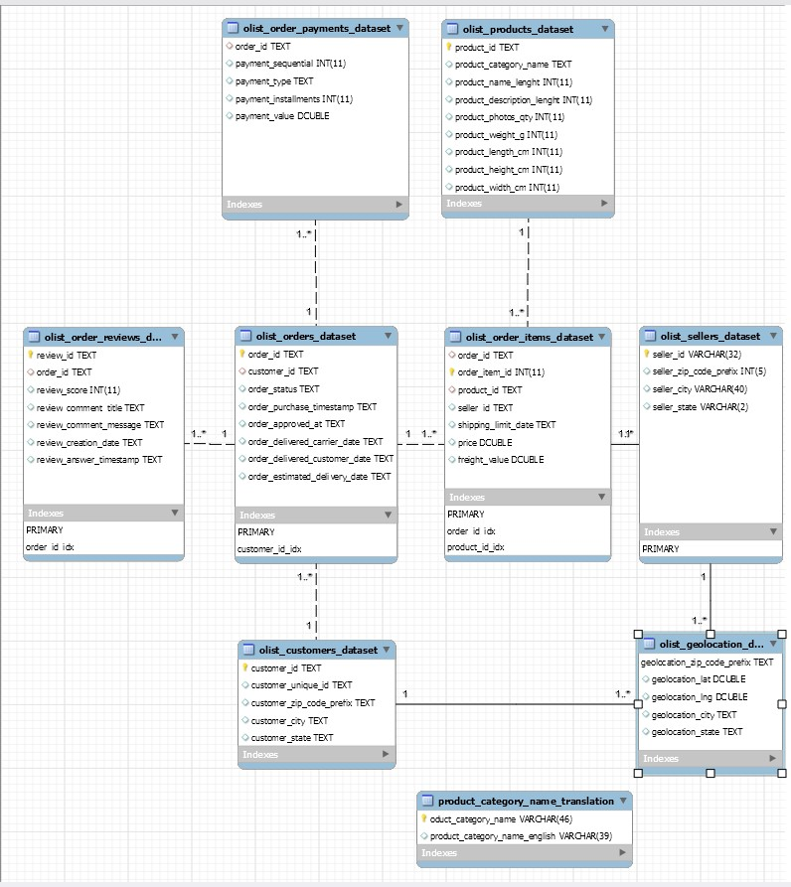
Database ER Diagram

Slide 7
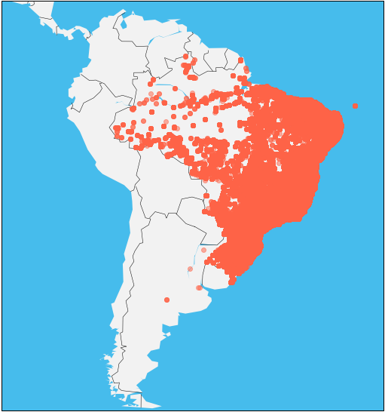
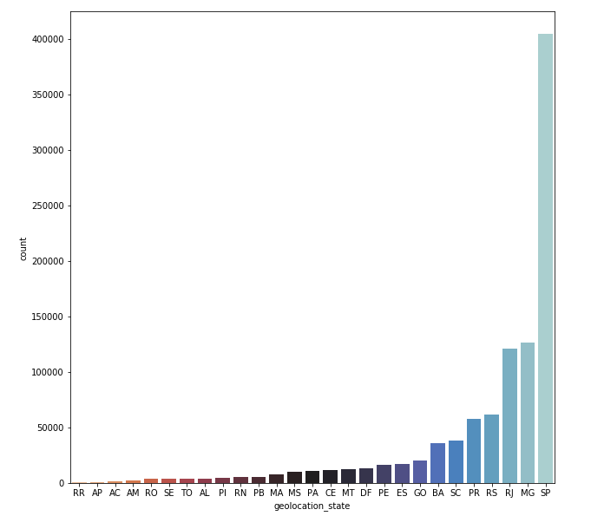
Geo Exploratory

Slide 8
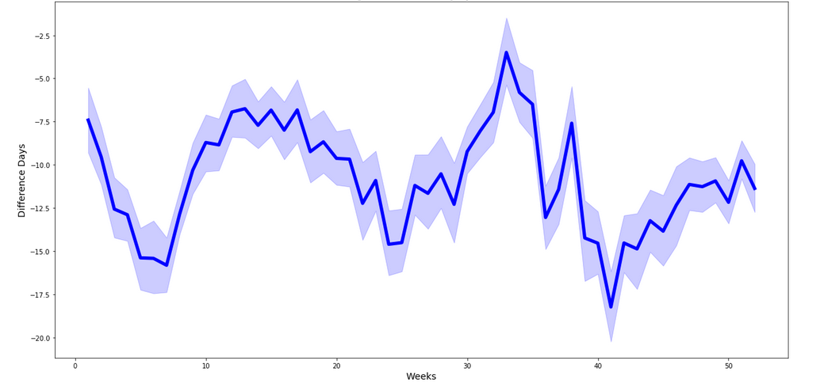
Average Difference Days per Week

Slide 9
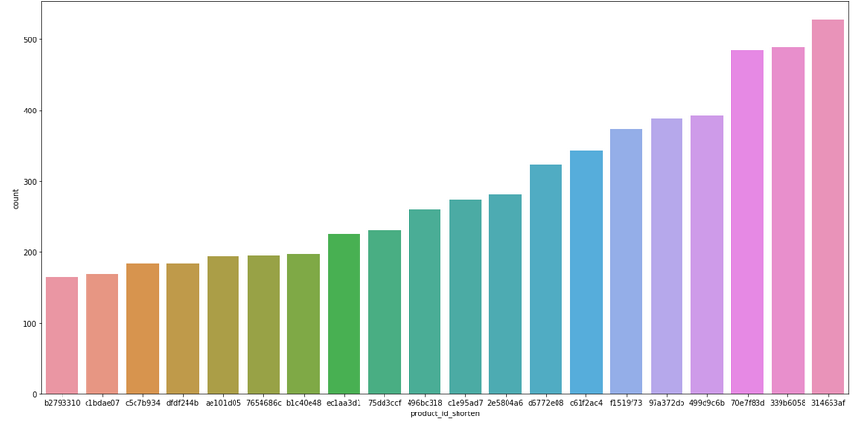
Top 20 Products

Slide 10
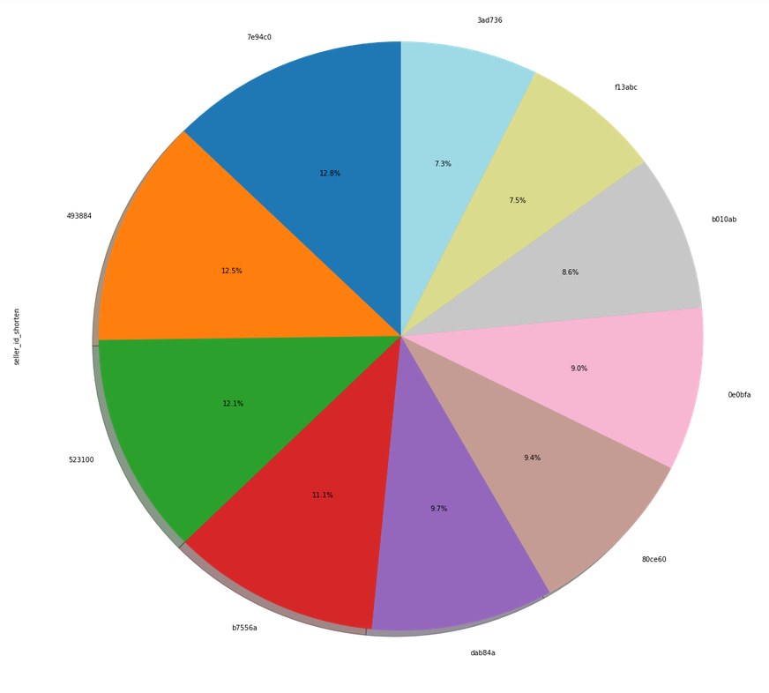
Top 10 Sellers

Slide 11
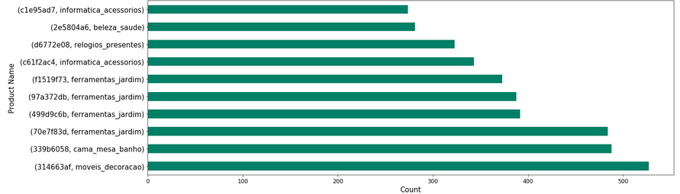
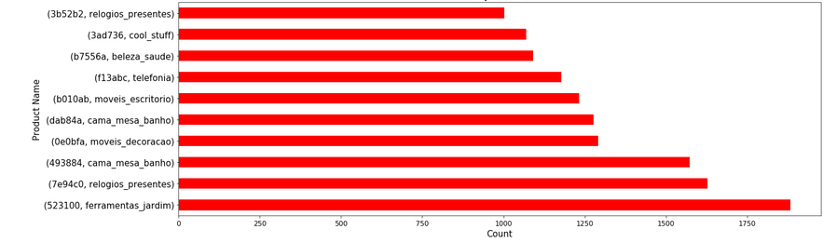
Top 10 Products Category
Top 10 Sellers Category

Slide 12
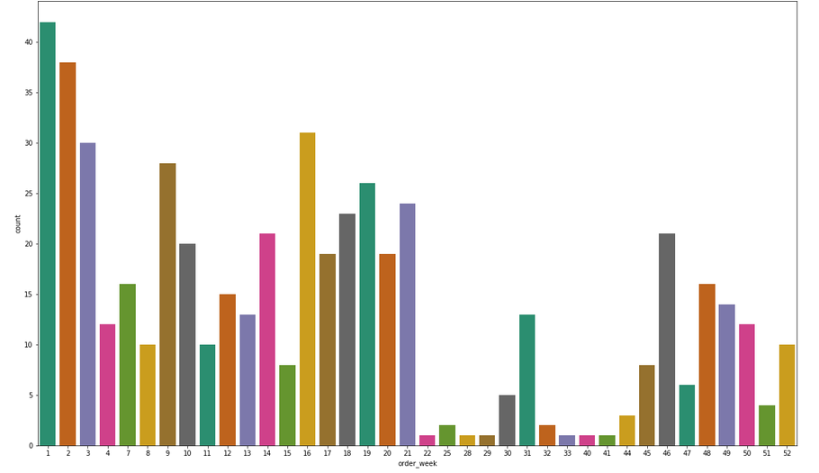
Weekly Purchase of Home decoration Products

Slide 13
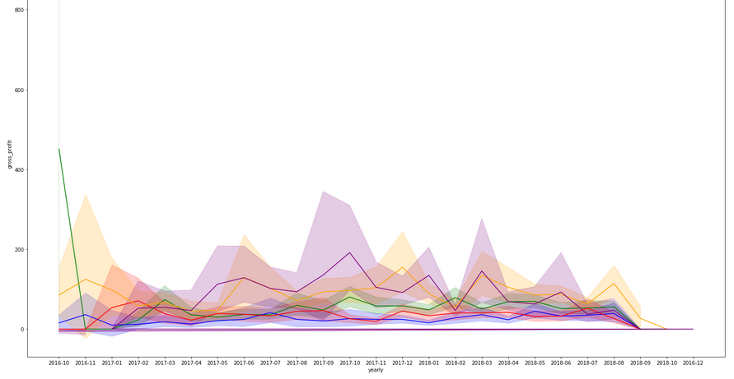

Gross-Profit of top 5 products

Slide 14
Cutomer Satisfaction Prediction
The goal of this project is to analyze what makes up satisfaction and disappointment.
We will not focus on review scores prediction but rather on discovering where to take actions for increasing customer satisfaction.
We ﬁrst try to understand which features are relevant to determine the review score.

Slide 15
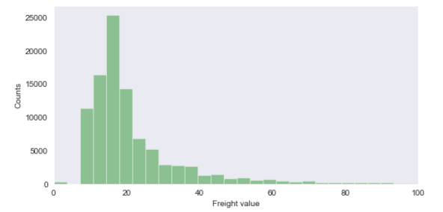
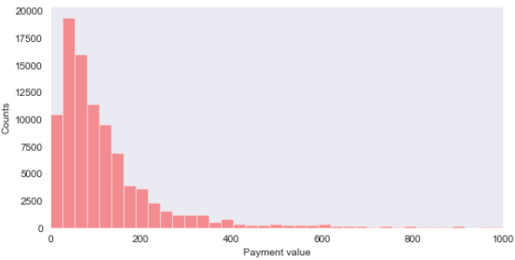
Customer behavior

Slide 16
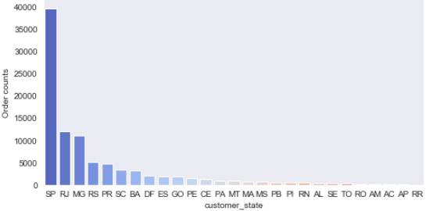
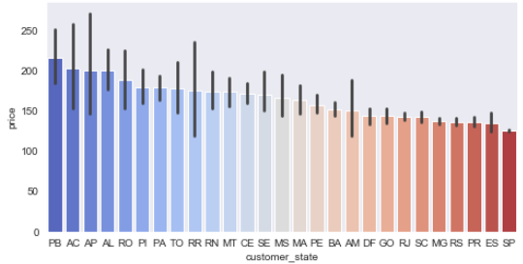
Customer origin

Slide 17
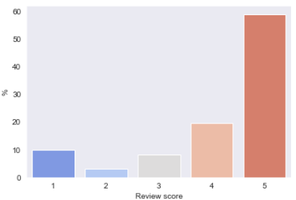
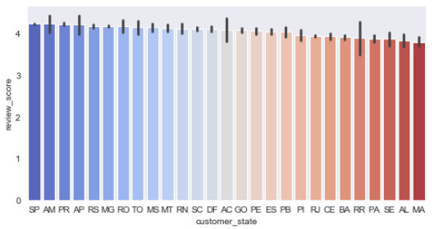
Review statistics

Slide 18
Review Analysis
We create new features that will can have an effect on the review score
The estimated and real delivery time
The delay in days (if order arrives in advance, it is just zero delays)
A binary for review received before delivery. If the review has been received before the delivery: 1 otherwise: 0
A binary for lateness. If the delivery is delayed: 1 otherwise:0
The freight ratio = freight_value/payment_value

Slide 19
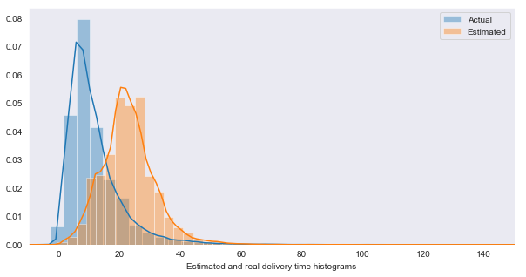
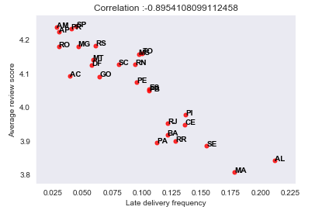
I. Distribution of real and estimated delivery times
II. Correlation Late frequency vs Review score

Slide 20
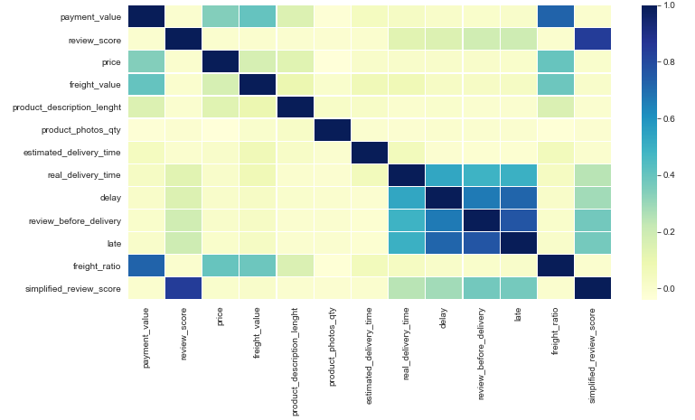
Correlation Matrix

Slide 21
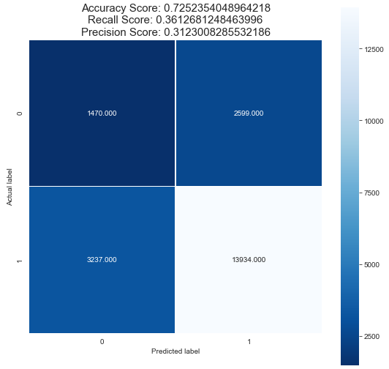
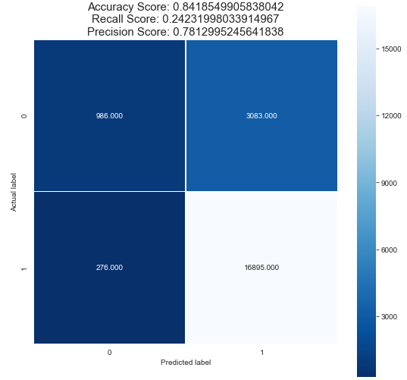
Decision Tree Classifier:Confusion Matrix
Baseline Model
Model with Best Parameters

Slide 22
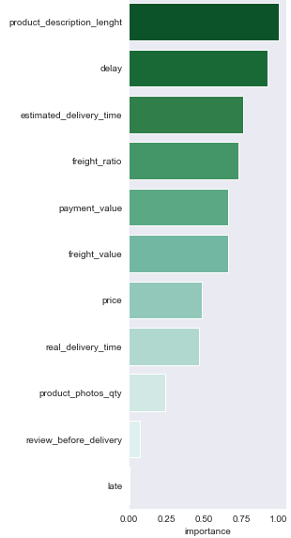
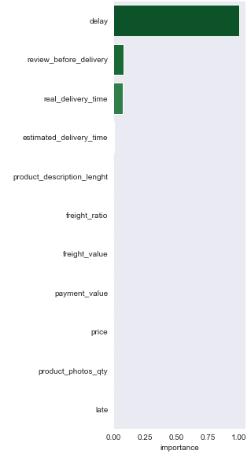
Decision Tree Classifier:Important Feature Interpretation
Baseline Model
Model with Best Parameters

Slide 23
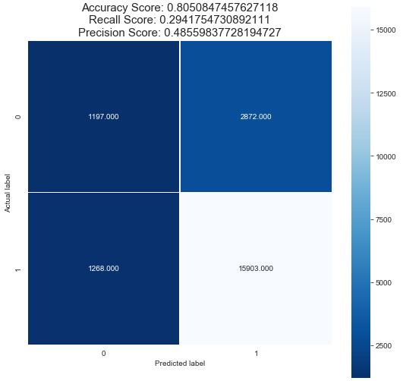
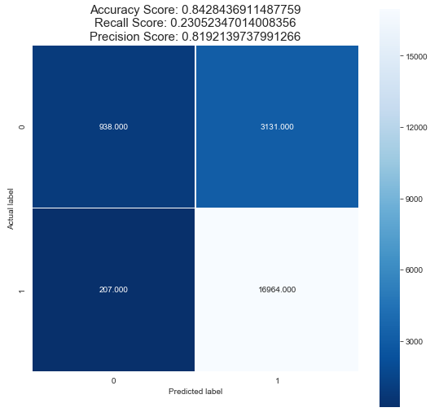
Extra Tree Classifier:Confusion Matrix
Baseline Model
Model with Best Parameters

Slide 24
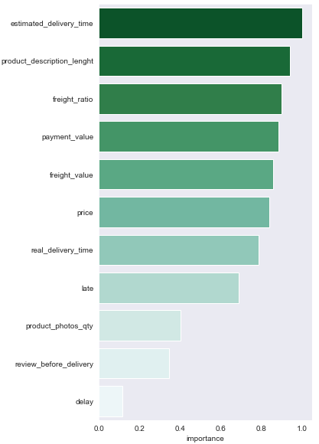
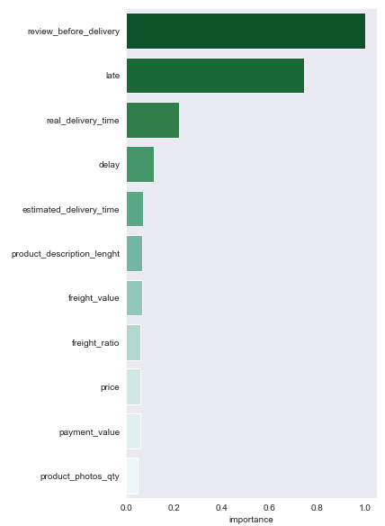
Extra Tree Classifier:Important Feature Interpretation
Baseline Model
Model with Best Parameters

Slide 25
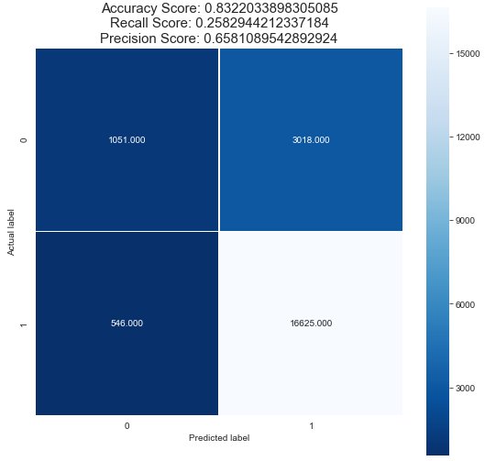
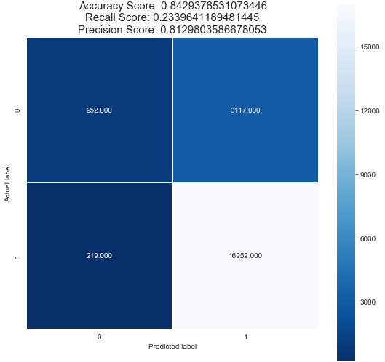
Random Forest Classifier:Confusion Matrix
Baseline Model
Model with Best Parameters

Slide 26
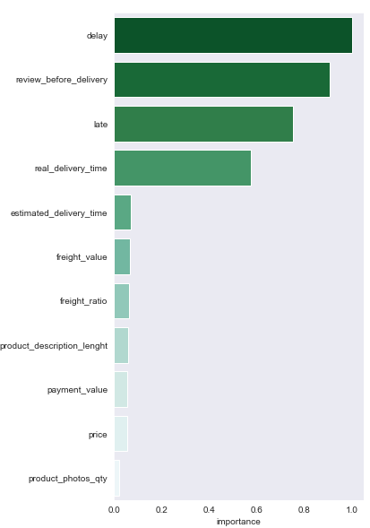
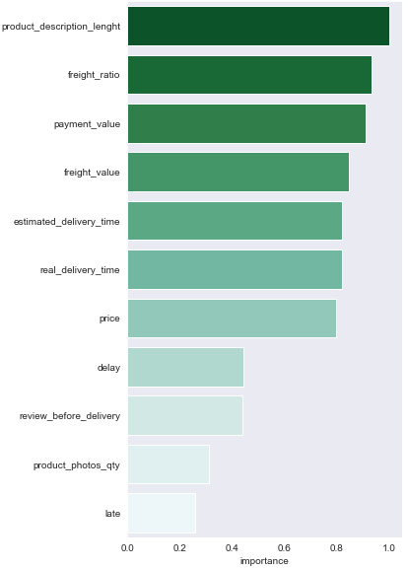
Random Forest Classifier:Important Feature Interpretation
Baseline Model
Model with Best Parameters

Slide 27
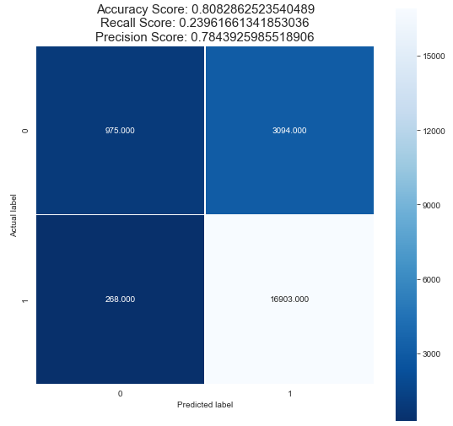

XGBoost Classifier:Confusion Matrix
Baseline Model
Model with Best Parameters

Slide 28
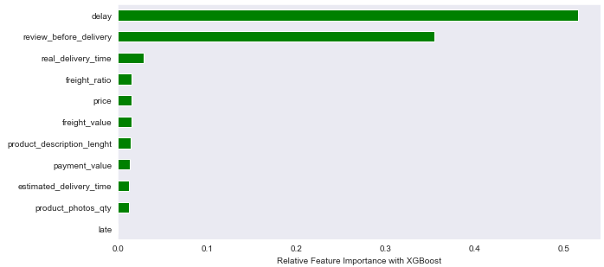
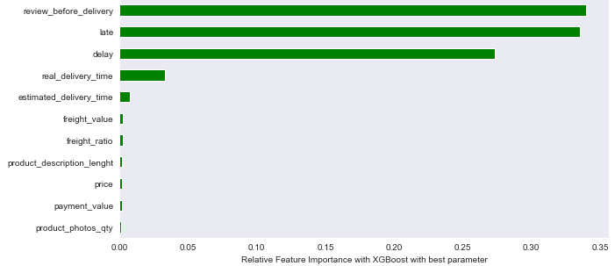
XGBoost Classifier:Important Feature Interpretation

Slide 29
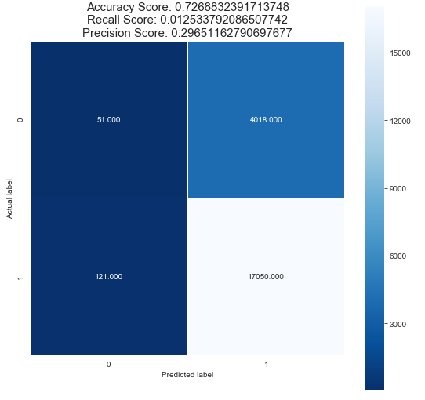
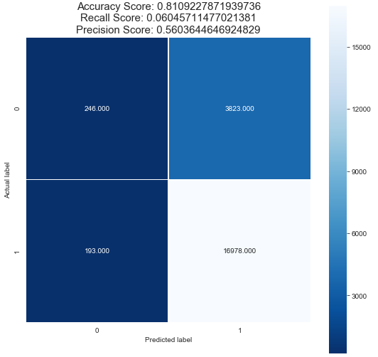
SVM Classifier:Confusion Matrix
Baseline Model
Model with Best Parameters

Slide 30
Future work
1.Dataset preprocessing must be improved further to produce better result.
2.Hyperparameter optimization can be improved by trying with unused combination of parameters.
3.Using only the top best important features with algorithm can improve model performance.
4.Use different parameter with different values can also improve the model performance in future.

Slide 31
Conclusion
As our model performance is good still need a improvement in future.
Those were highlighted by customers directly on the surveys through review comments.
Customers were happy when the order was shipped fast, i.e, before the estimated delivery date and the received product quality matched their expectations online. Likewise, they did not hesitate to show their discontent when it was not the case.

Slide 32


